Slide 1
Cal State Fullerton Philanthropic Foundation UA Administration and Finance
Financial Reports Portal Training July 2022

Slide 2
Getting to the Reports Portal
URL: http://foundation.fullerton.edu/
Or go to www.fullerton.edu, University Advancement, Foundation tab
Click on Reports tab
Notes:
Describe a little how advancement services accepts the gift and can answer any gift related questions

Slide 3
Report Description
Acct Info: Account/Project name and number, Authorized signers, view only reports, Purpose of Account, if Endow, includes Dist #
Detailed Trans: Revenue and expense detailed, Date , Invoice, Description, Amount, Balance of Object Code
Gl Inquiry Bal: Project, Project Title, Authorized Signers, Object Code and Name, Budget to Actual, Encumbrance,
Cash Bal: Account/Project name and number, College Code, Fund, Cash balance
Campus Prg & Sch: Project, Project Title, Month to Date, Fiscal Year to Date Actual, FYTD Encumbrances, Total FYTD Actual + FYTD Encmb,
Endowment: Project, Project Title, Month to Date Trans Tlt, Fiscal Year to Date Actual, Endowment Inception to Date Summary
Endow BV to MV: College, Account#, Distribution#, Endowment Account Name, Market Value, Book Value, Spending Distribution, Distribution Cash Balance

Slide 4
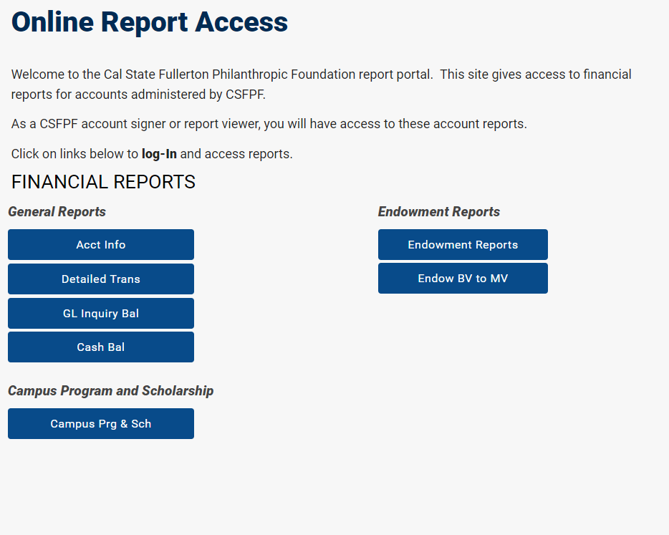
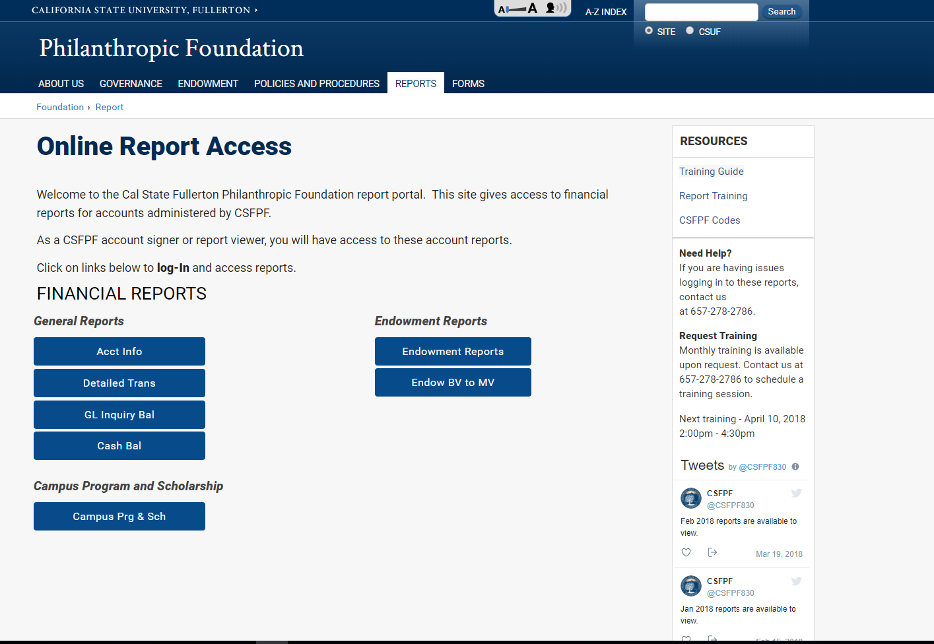
Selecting Report Type
Click report type
Enter ad\campus username and password once

Slide 5
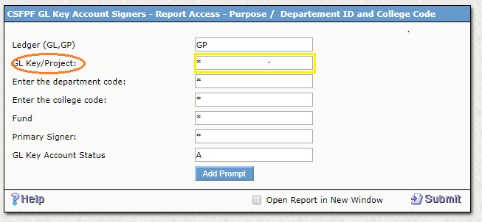
Account Info : GL_KEY
Ledger default: GP
Use GL if retrieval data for 6/30/15 and prior
Use GL Key as Project for individual account

Slide 6
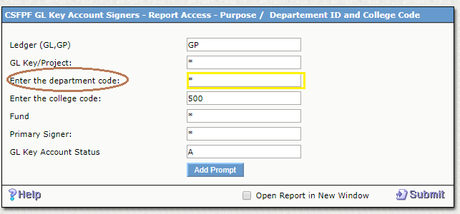
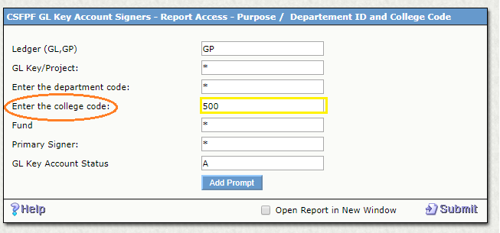
Account Info : GL_KEY
Use Department Code if available within College
Use College Code for all college accounts

Slide 7
Cash Bal : CSFPF Active Account Balance by College(CONT.)
From above given options Project Key/Department Code/College Code/Fund you can choose any option depending
on requirements.

Slide 8
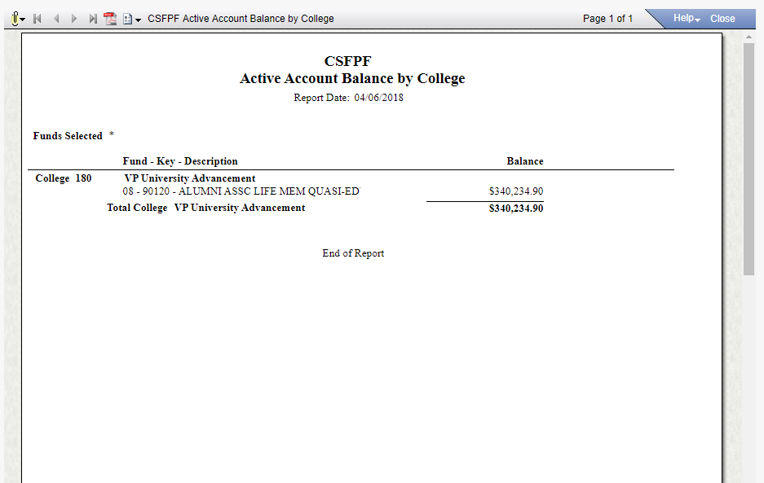
Cash Bal : CSFPF Active Account Balance by College(CONT.)
After Entering Project Key it will direct to
following window.
Final Report

Slide 9
CSFPF Campus Program/Scholarship Report
Ledger default: GP
Use GL if retrieval data for 6/30/15 and prior
Use Project for individual account
If available …, use drop down to select

Slide 10
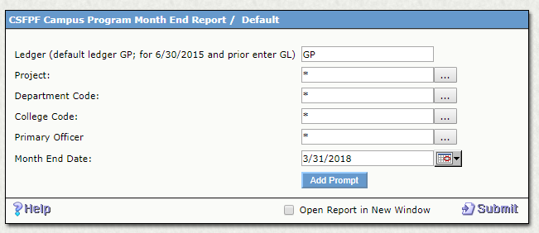
CSFPF Campus Program/Scholarship Report(CONT.)
Generating report using Project code as a parameter

Slide 11
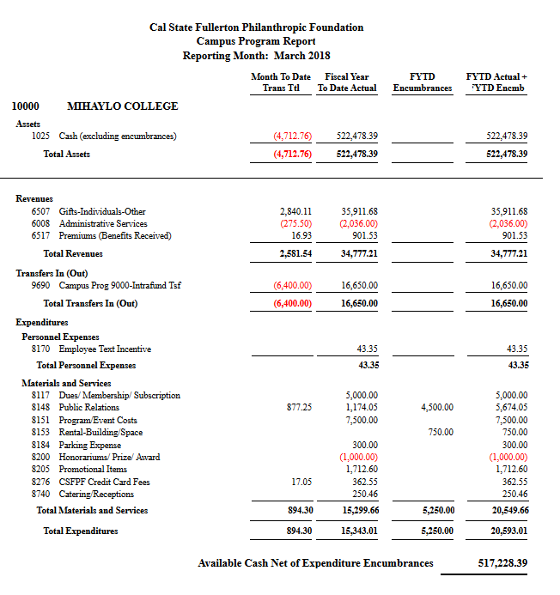
CSFPF Campus Program/Scholarship Report(CONT.)
Sample report:
Drill down to show detailed
Month to Date- Current month
Fiscal Year to Date Actual will include July, August, Sept for Sept selection
Object Code 1025 is Cash Balance
Available Cash Net of Expenditure Encumbrances: 1025 minus PO

Slide 12
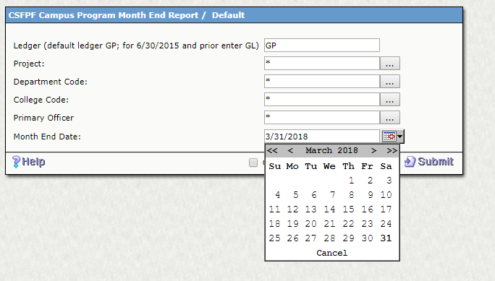
CSFPF Campus Program/Scholarship Report(CONT.)

Slide 13
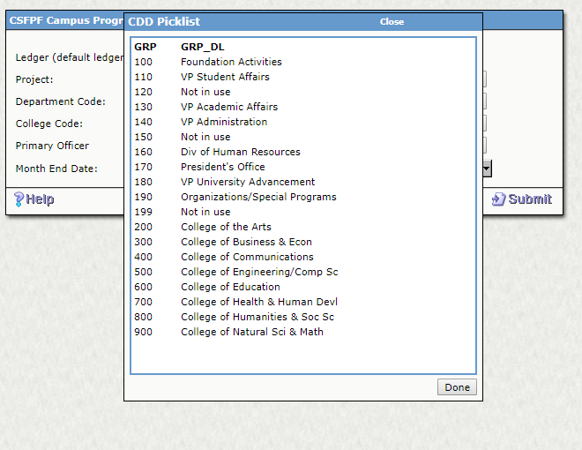
CSFPF Campus Program/Scholarship Report(CONT.)
Generating report using College code as a parameter

Slide 14
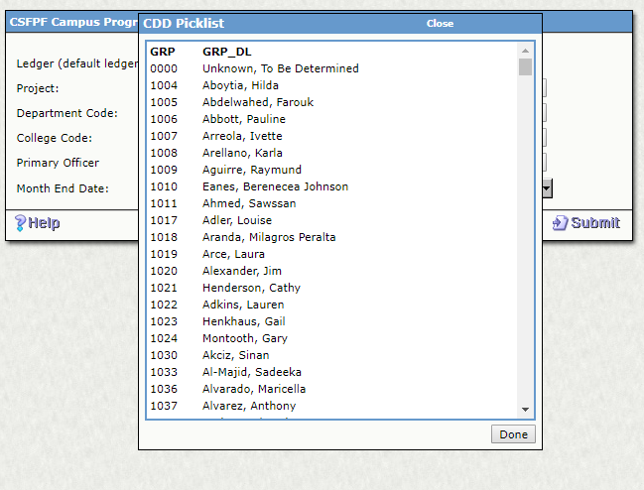
CSFPF Campus Program/Scholarship Report(CONT.)
Generating report using Department Code as a parameter

Slide 15
Endowment Report
Ledger default: GP
Use GL if retrieval data for 6/30/15 and prior
Use Project for individual account
If available …, use drop down to select
School for College Code
Check Open Report for new window

Slide 16
Endowment Report (CONT.)
Generating report using Project code as a parameter

Slide 17
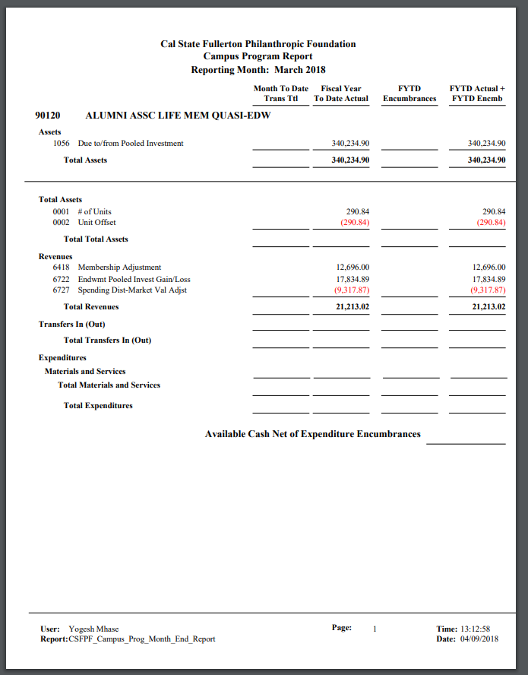
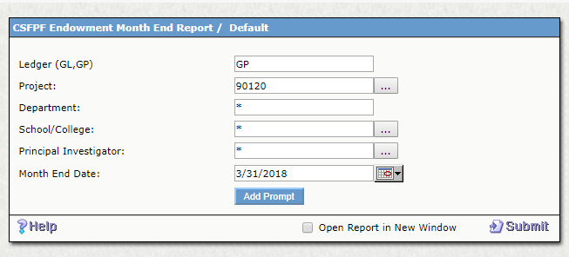
Endowment Report (CONT.)

Slide 18
Endowment Report (CONT.)
Generating report using School code as a parameter

Slide 19
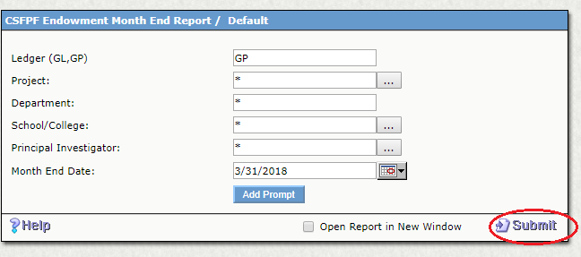
Endowment Report (CONT.)

Slide 20
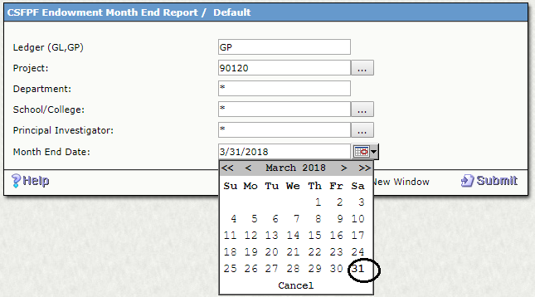
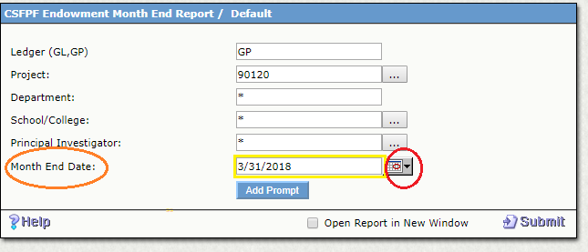
Endowment Report (CONT.)

Slide 21
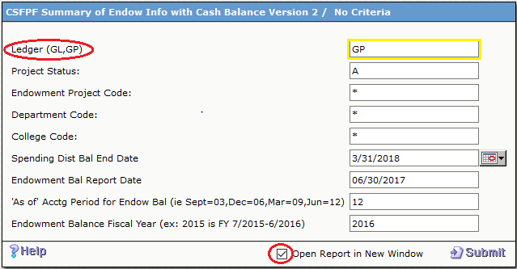
Endowment BV to MV(CONT.)
Ledger default: GP
Use GL if retrieval data for 6/30/15 and prior
Use Project for individual account
Spending Dist Bal End Date: Use Qtr End
Endowment Bal Report Date-06/30/2016 -Acctg Period Endow for Jun= 12
Endow Bal FY: 07/01/2016-06/30/2017 Use 2016

Slide 22
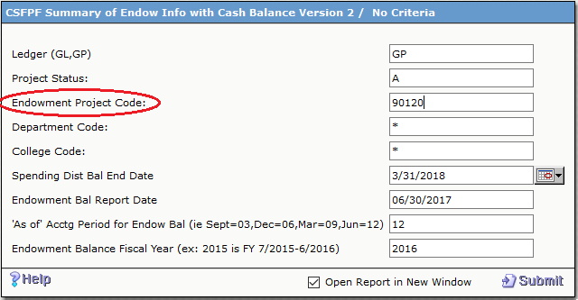
Endowment BV to MV(CONT.)
Use Project for individual account
Use College Code for all College Accounts
Use Department ID if available within College

Slide 23
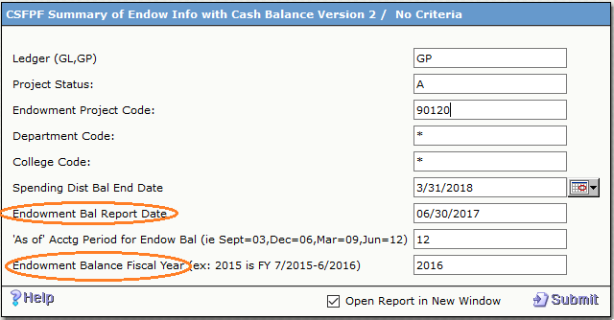
Endowment BV to MV(CONT.)
Spending Dist Bal End Date: Use Qtr End
Endowment Bal Report Date-06/30/2017 -Acctg Period Endow for Jun= 12
Endow Bal FY: 07/01/2016-06/30/2017 Use 2016

Slide 24
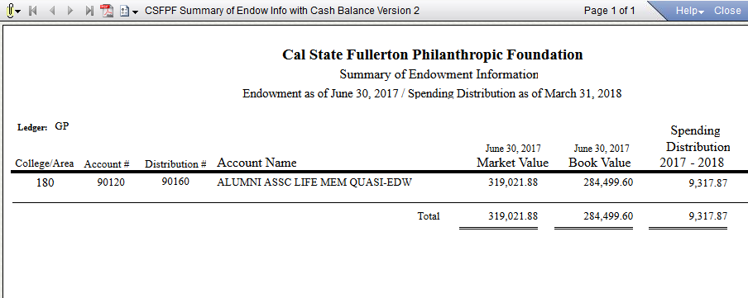
Endowment Report Ver. II
Endowment BV to MV(CONT.)
Provide Total market value and book value of endowments for your college
Spending Distribution if available
Cash balance for spending account

Slide 25
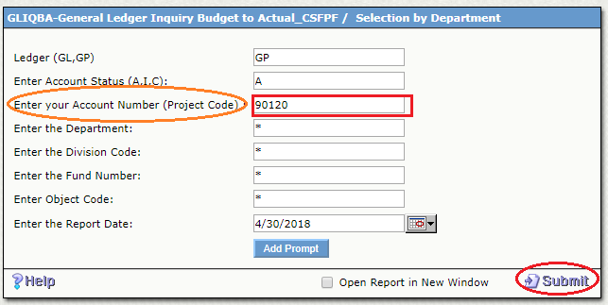
GLIQBA: GL Inquiry Bal

Slide 26
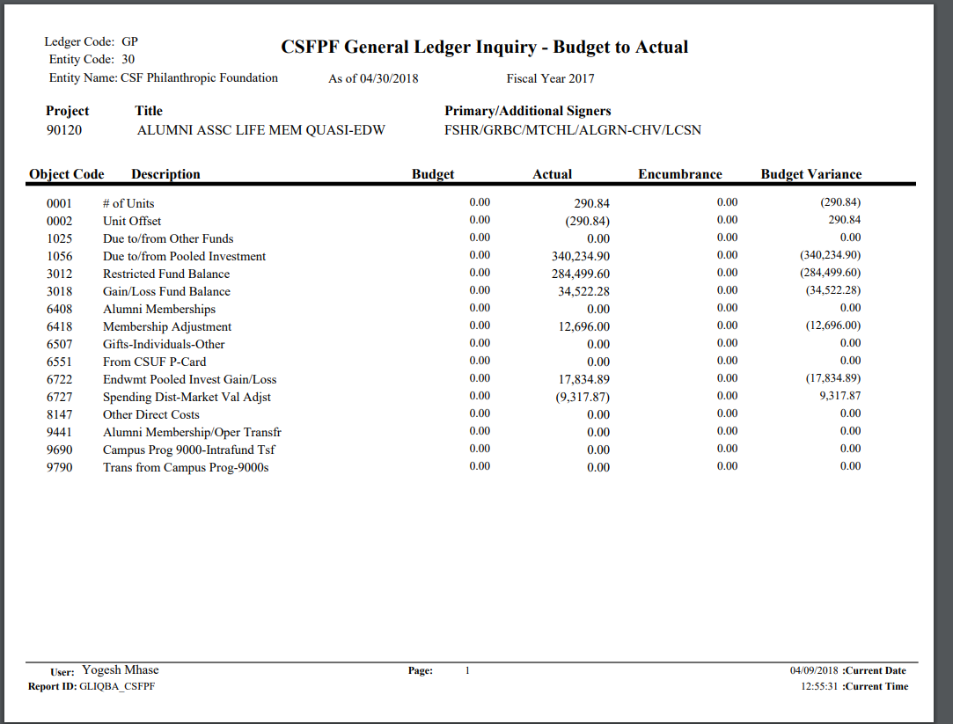
GLIQBA: GL Inquiry Bal(CONT.)

Slide 27
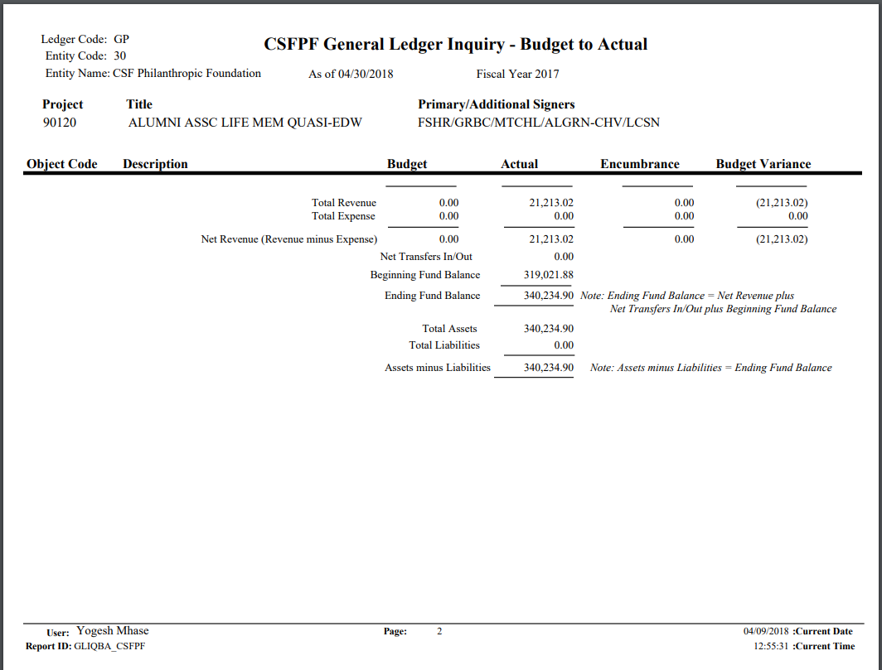
GLIQBA: GL Inquiry Bal(CONT.)

Slide 28
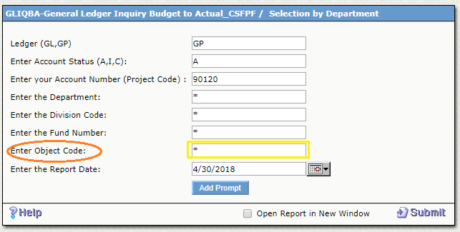
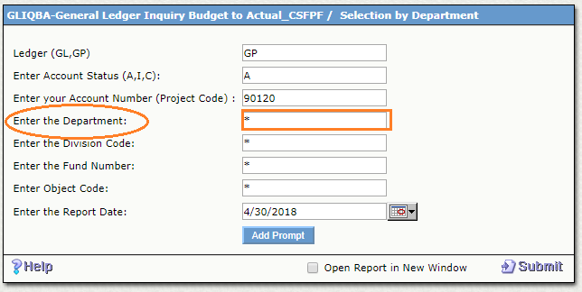
GLIQBA: GL Inquiry Bal(CONT.)
Dept ID with your College if available
Revenue Code (6*), Expense Code (8*), Transfer Code (9*)

Slide 29
Object Codes
Revenue Code (6*), Expense Code (8*), Transfer Code (9*)

Slide 30
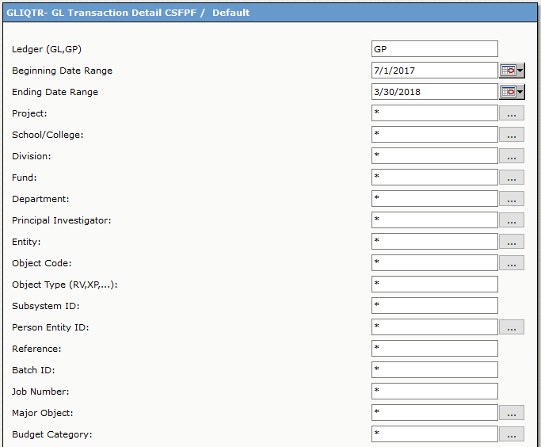
GLIQTR: Detailed Transactions

Slide 31
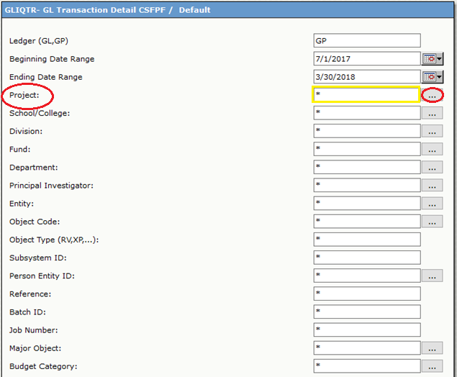
GLIQTR: Detailed Transactions(CONT.)

Slide 32
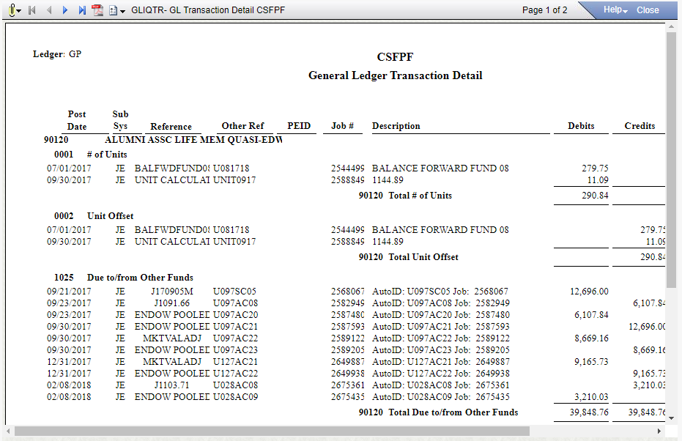
GLIQTR: Detailed Transactions(CONT.)

Slide 33
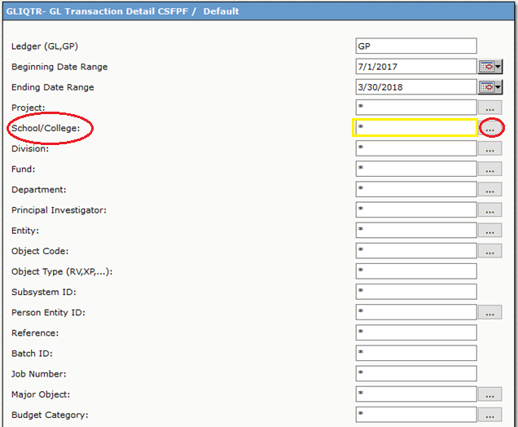
GLIQTR: Detailed Transactions(CONT.)

Slide 34
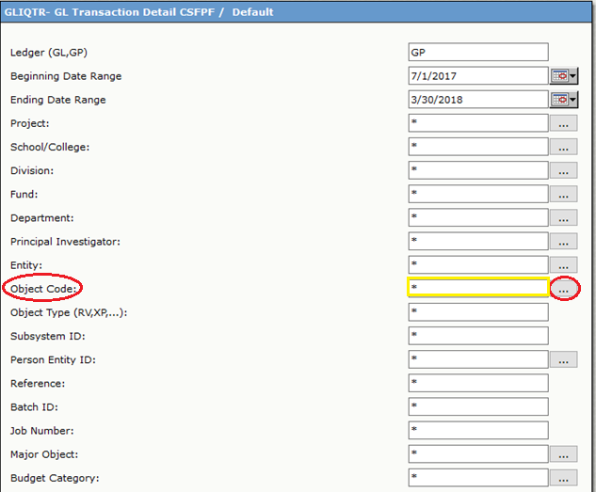
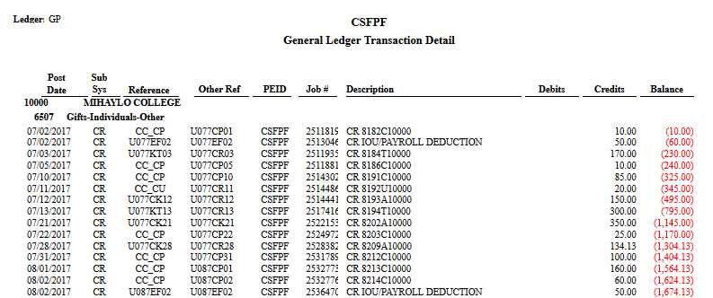
GLIQTR: Detailed Transactions(CONT.)
Used to request from Advancement services gift receipt information

Slide 35
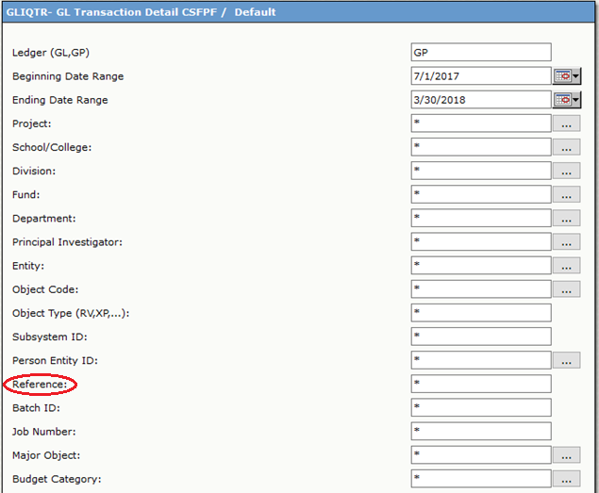
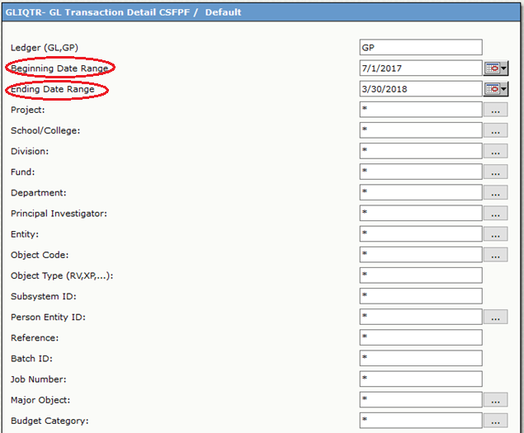
GLIQTR: Detailed Transactions(CONT.)

Slide 36
Cal State Fullerton Philanthropic Foundation Contact: foundation@fullerton.edu (657) 278-2786
UA Administration and Finance Staff
Anh Chen ext. 8387
Le Lam ext. 2934
Susan Cervantes ext. 4420

